Slide 1
Taller Regional de Evaluación de Recursos Pesqueros con Datos Limitados y Pesquería del Dorado en el Océano Pacífico Oriental
Yves Reecht (yves.reecht@hi.no)
Hector Andrade (hector.andrade@hi.no)
Instituto de Investigaciones Marinas
Cali, Colombia 26-29 de Mayo 2025

Slide 2
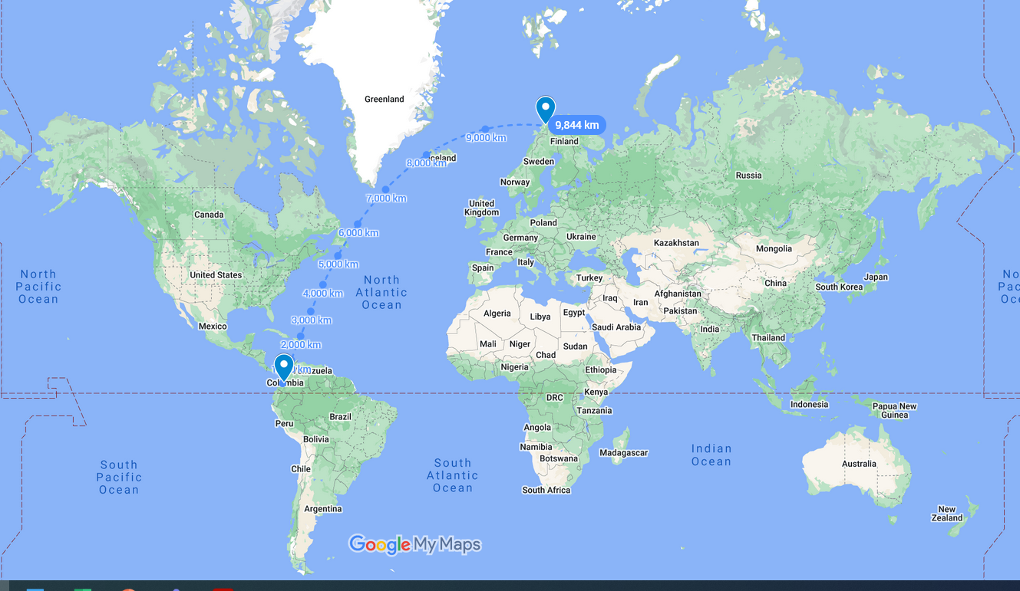

Slide 3
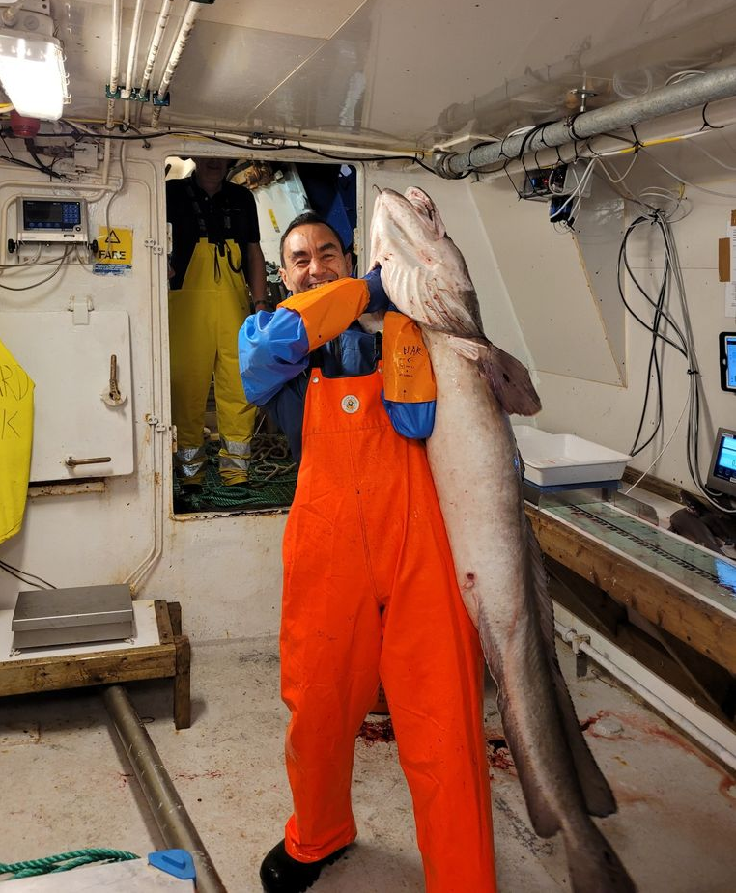
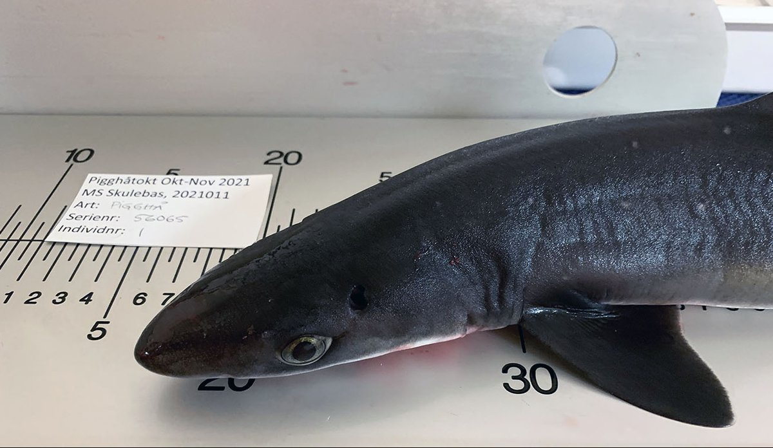
«Maruca» Molva molva
Trabajo con especies para las que no hay muchos datos «datos limitados»
Aprovechando los datos que hay para apoyar la evaluación de pesquerías
Haciendo investigación para recabar información que falta
Tiburón mielga, galludo o tollo de cacho Squalus acanthias

Slide 4
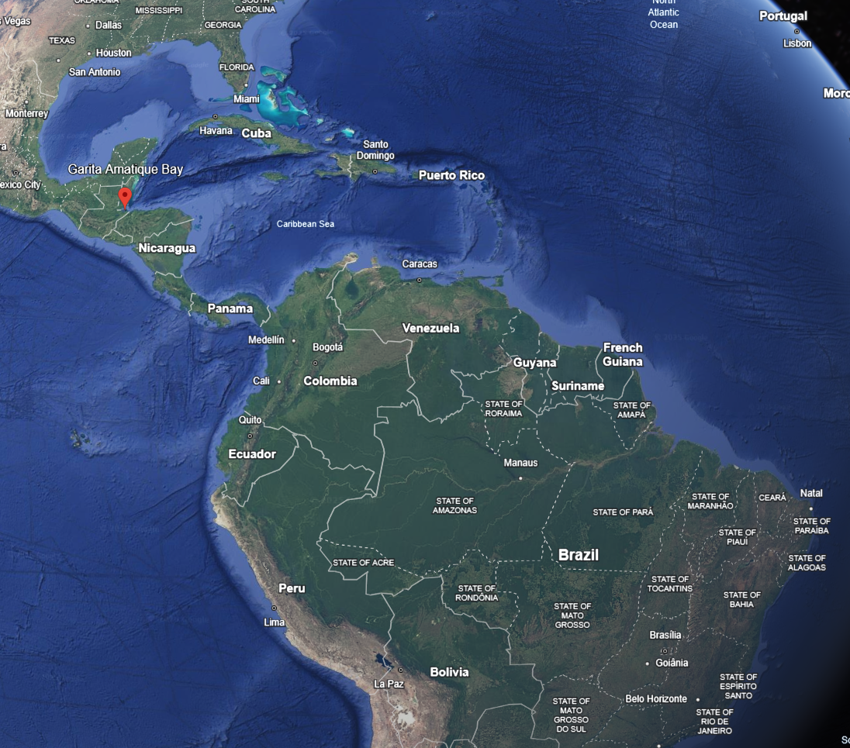
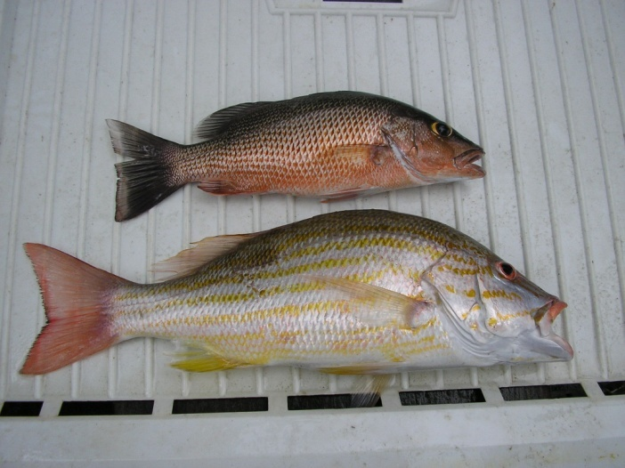

Slide 5
Evaluacion de stocks con datos limitados -dorado en Colombia
Como llegamos aquí?
Taller para identificar datos disponibles, opciones para recolección de datos, evaluación del stock y manejo de la pesquería en el Pacífico colombiano
Fishpath - Buenaventura, Colombia 7-9 de noviembre 2022

Slide 6
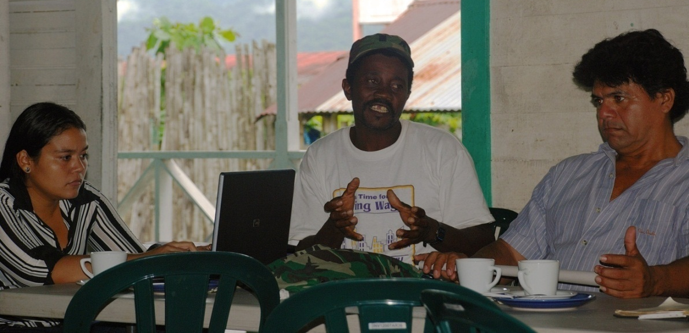

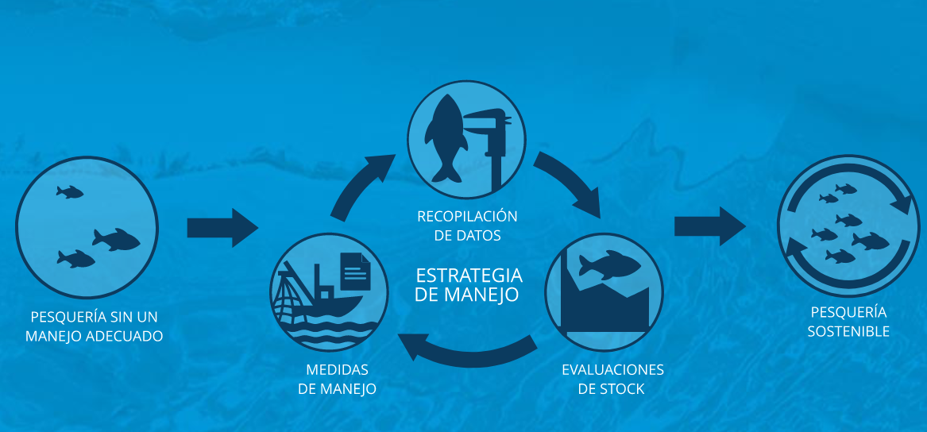
Qué es FishPath?
Es un proceso participativo, apoyado por una herramienta, que guía la gestión de las pesquerías por el camino hacia la sostenibilidad
FishPath nos ayuda a entender qué opciones de monitoreo/recopilación de datos, evaluación de stock, y medidas de manejo son más apropiadas para una pesquería determinada.
Desarrollada por TNC, la Oficina Nacional de Administración Oceánica y Atmosférica de Estados Unidos (NOAA) y la Organización de Investigación Científica e Industrial del Commonwealth de Australia (CSIRO).

Slide 7
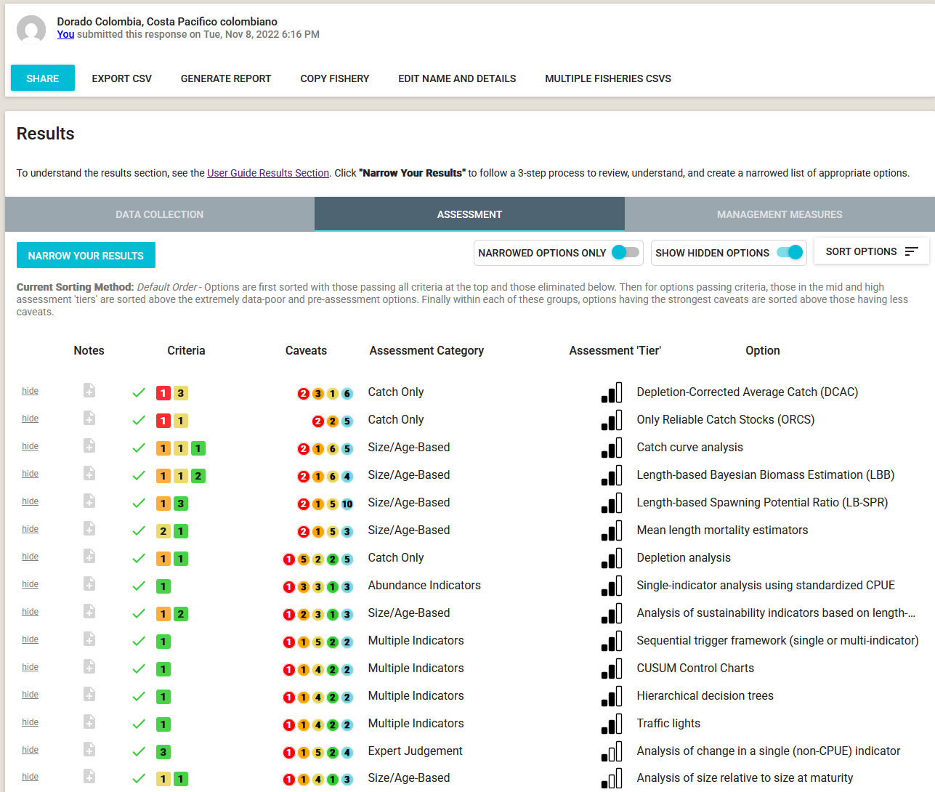

Slide 8

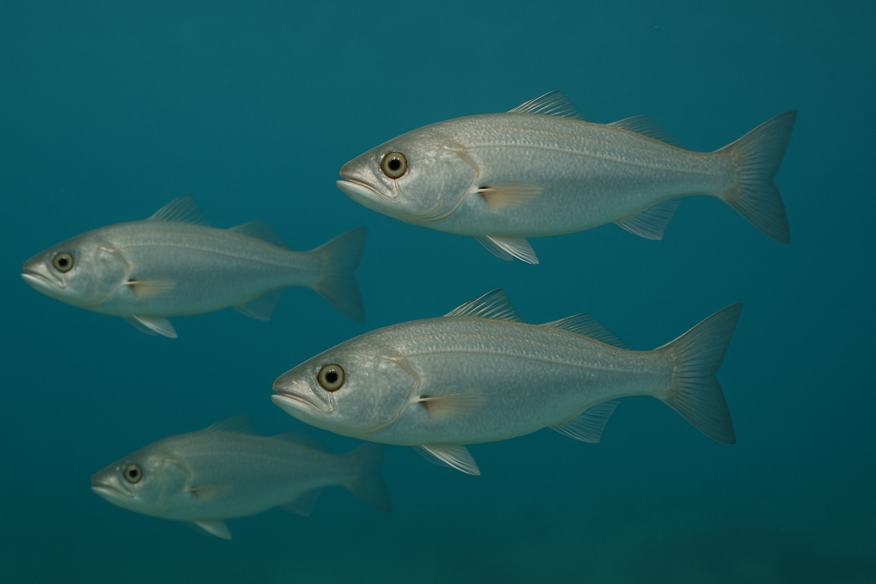
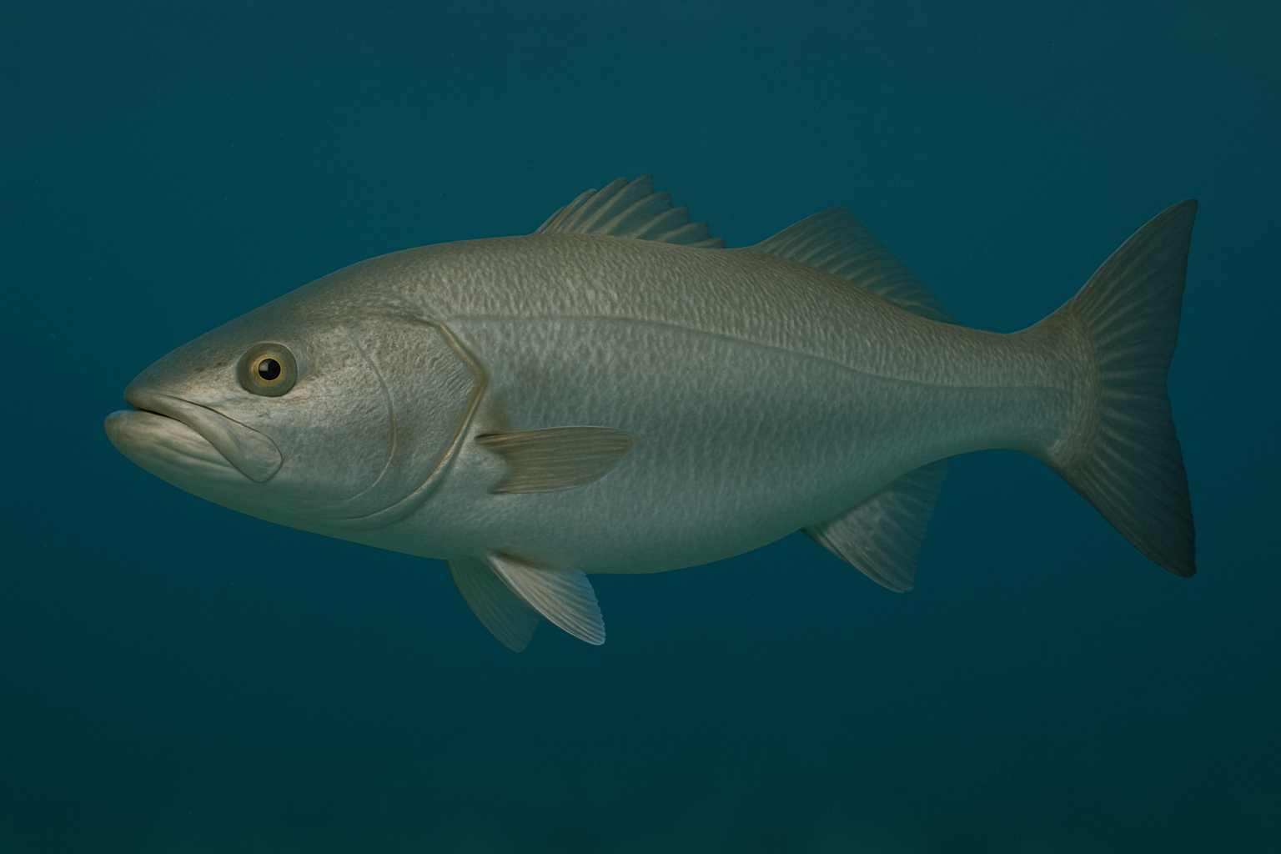

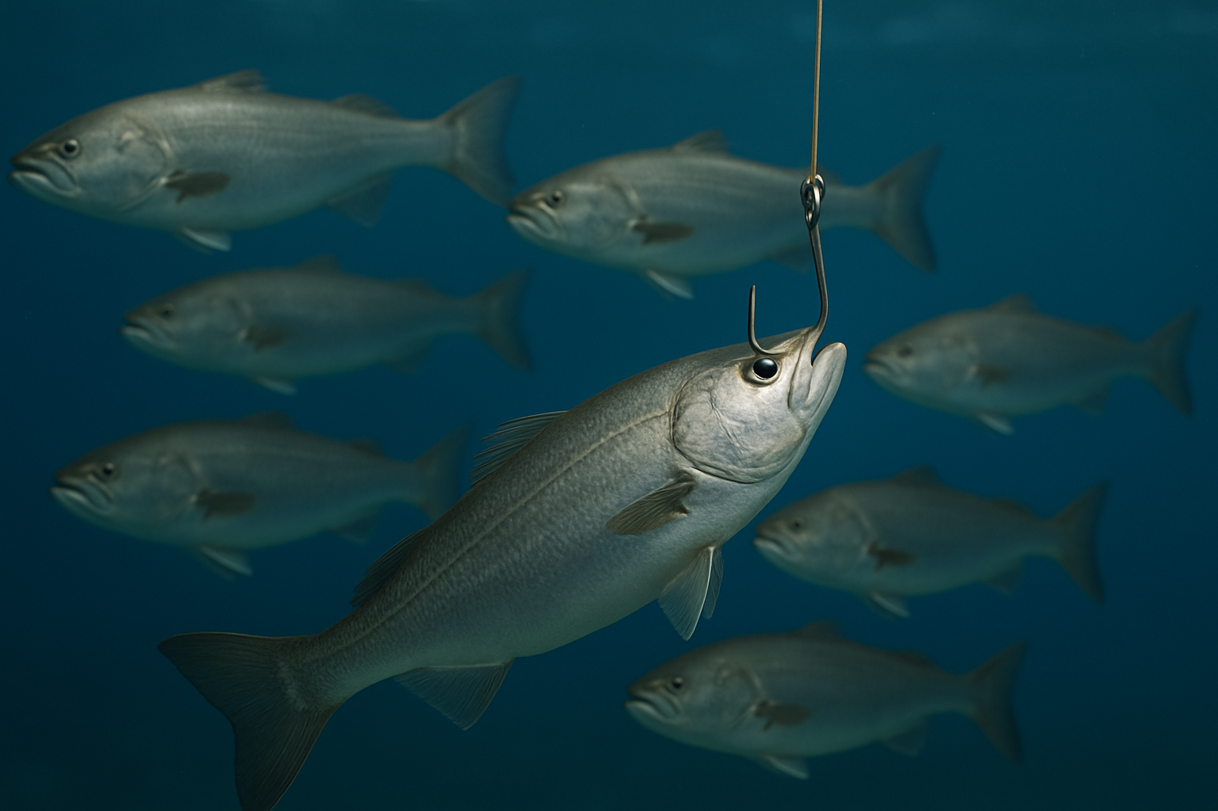
«An exploited fish stock viewed as a simple biological system» (King 1995) (Images by ChatGPT)
Growth
Recruitment
Natural mortality
Fishing mortality
Reproduction
King, M. (1995). Fisheries biology, assessment and management. Fishing News Books, Oxford, 341

Slide 9
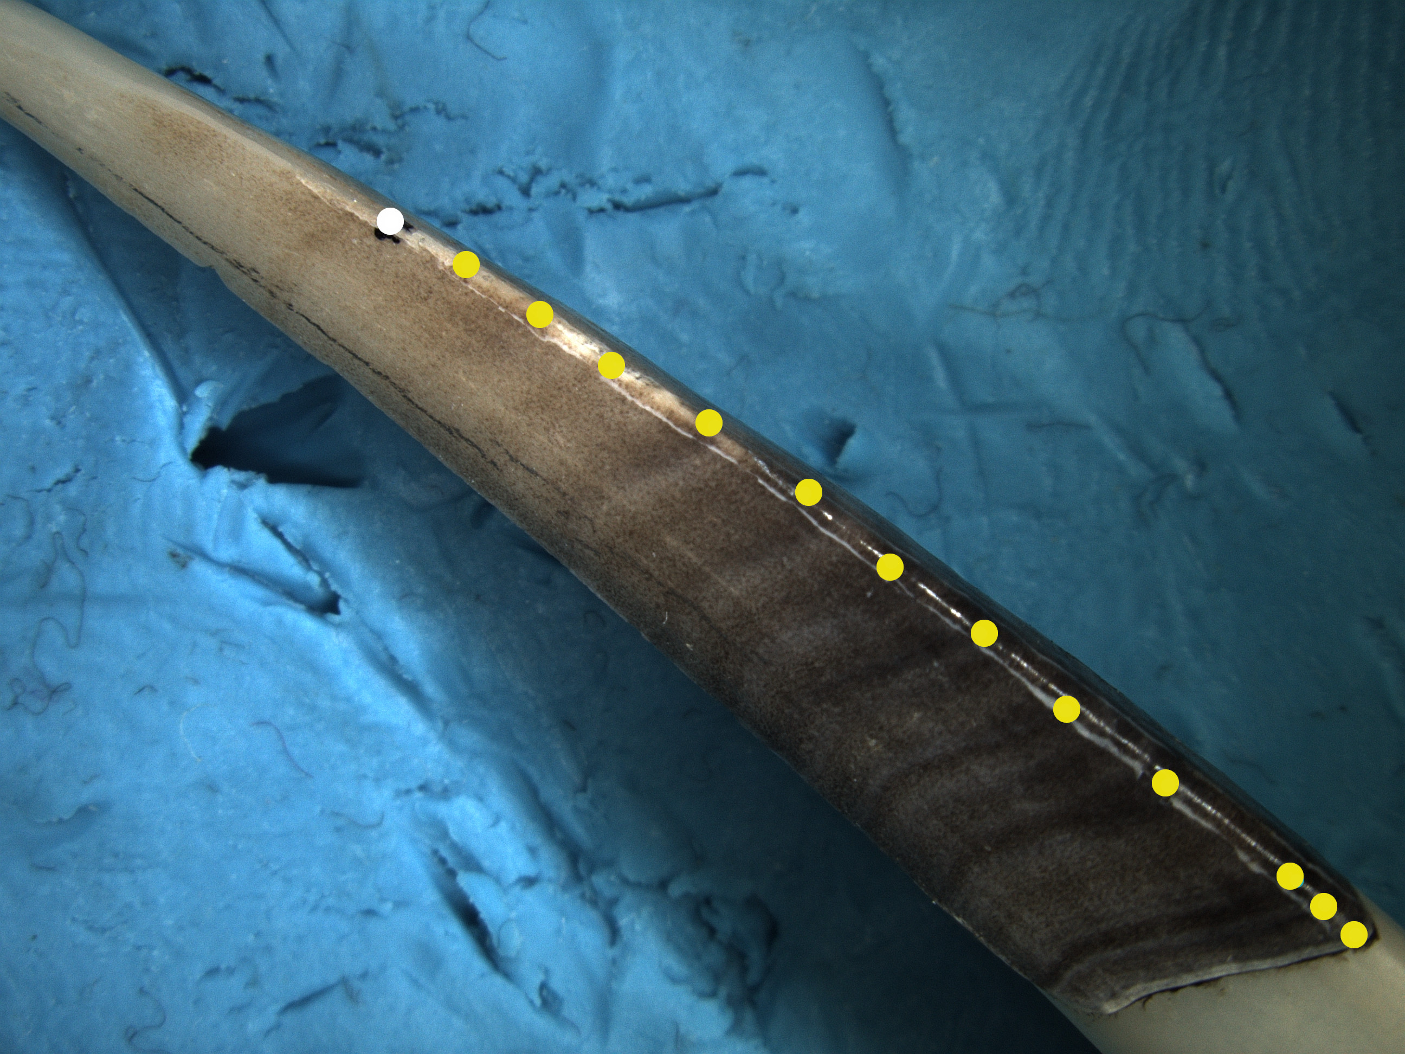
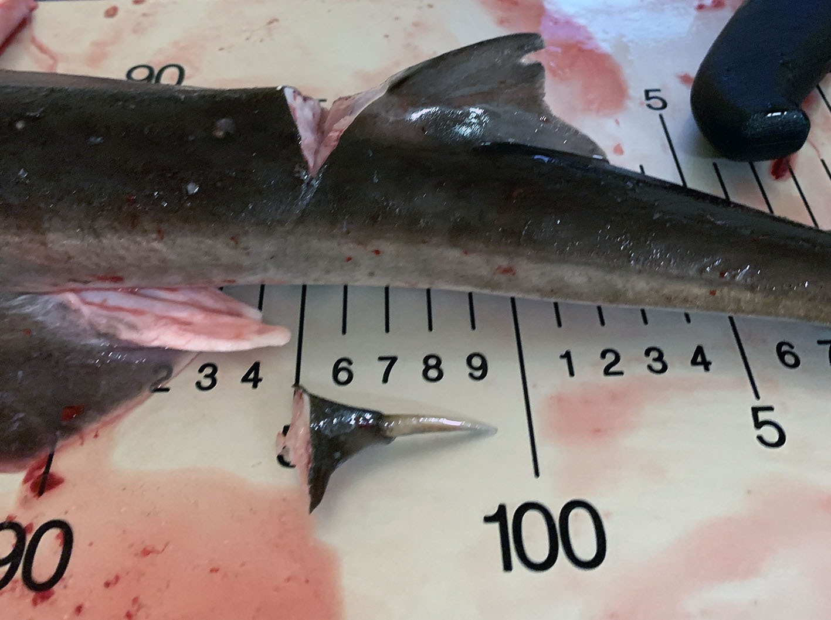

Crecimiento (von Bertalanffy)
$$L_{t}=L_{inf}\left(1−e^{−K\left(t−t_{0}\right)}\right)$$
Andrade, H., Nilsen, T., Vollen, T., Harbitz, A., Junge, C., & Albert, O. T. (2024). A longline survey for spurdog distribution and life history along the Norwegian coast. Fisheries Management and Ecology, 31(2), e12676. doi:https://doi.org/10.1111/fme.12676

Slide 10
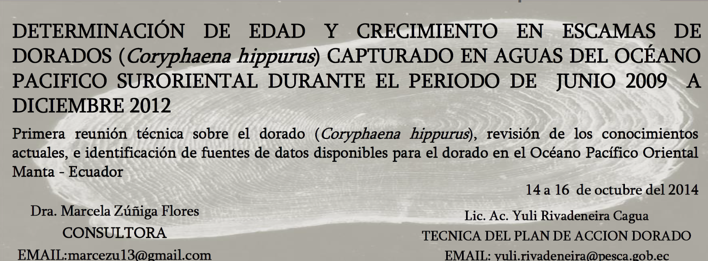
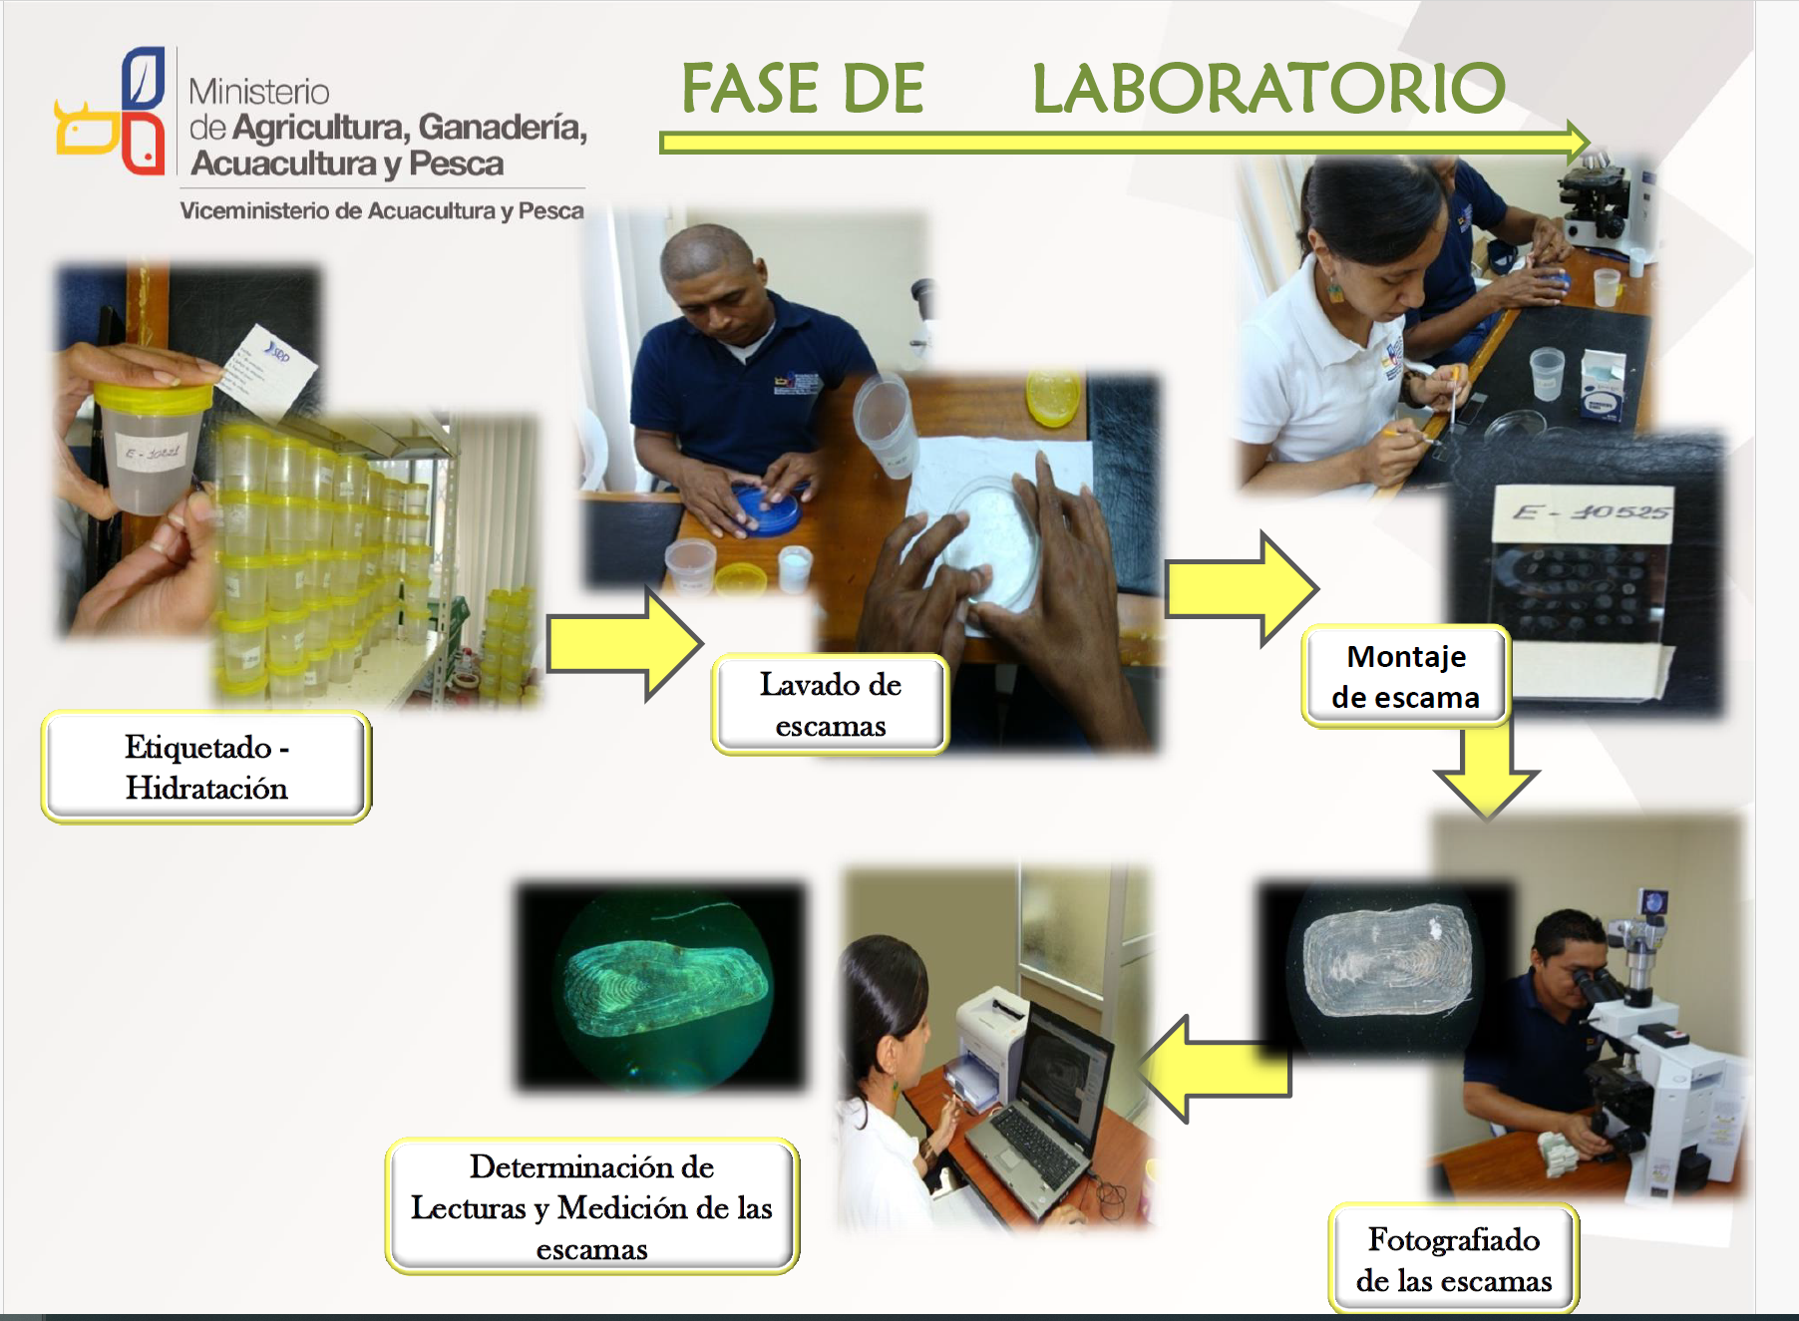
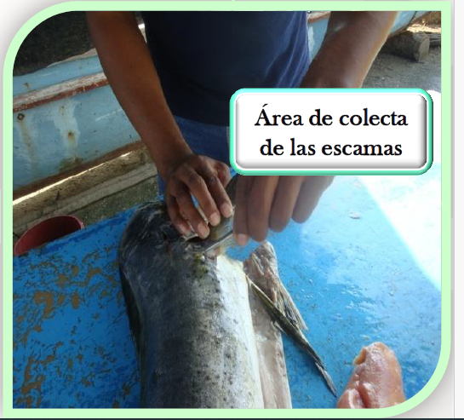
Determinando edad en dorado
https://www.iattc.org/GetAttachment/c06cfdf2-594b-4859-905b-515839f52f13/DOR-01-PRES_Determinacion-de-edad-y-crecimiento-en-escamas-de-dorados-capturado-en-aguas-del-Oceano-Pacifico-Suroriental-durante-el-periodo-de-jun-2009-a-dic-2012.pdf

Slide 11
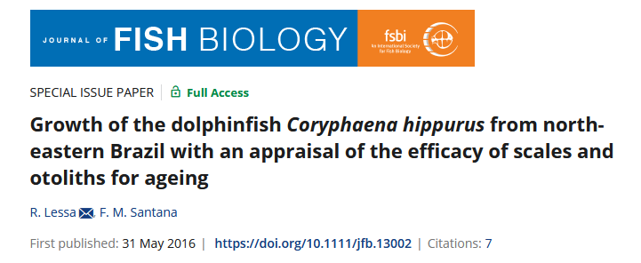
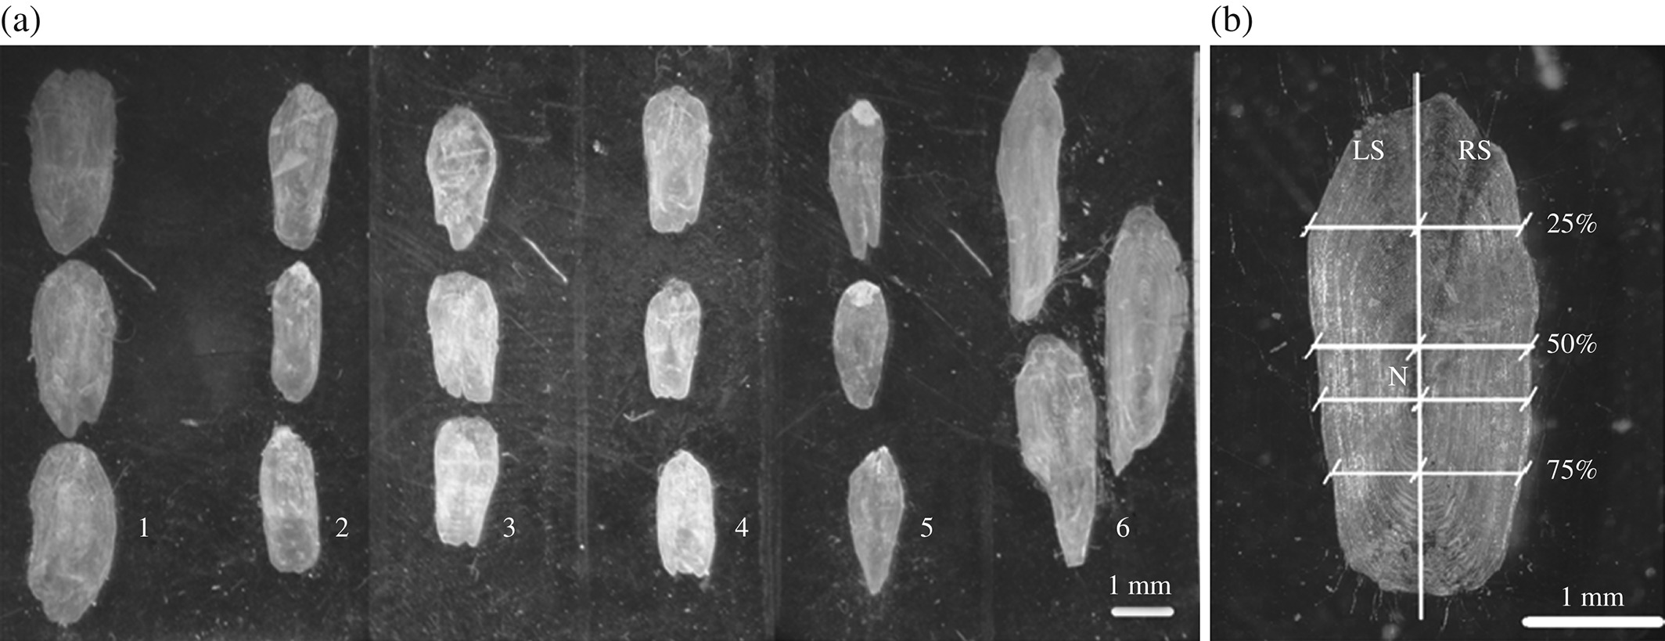
Scales of Coryphaena hippurus: (a) scales taken from six regions of body of same specimen: 1, caudal fin; 2, head; 3, anal fin; 4, pectoral fin; 5, pelvic fin; 6, dorsal fin and (b) measurements on left side (LS) and right side (RS) at 25, 50 and 70% of height and at core (N).

Slide 12
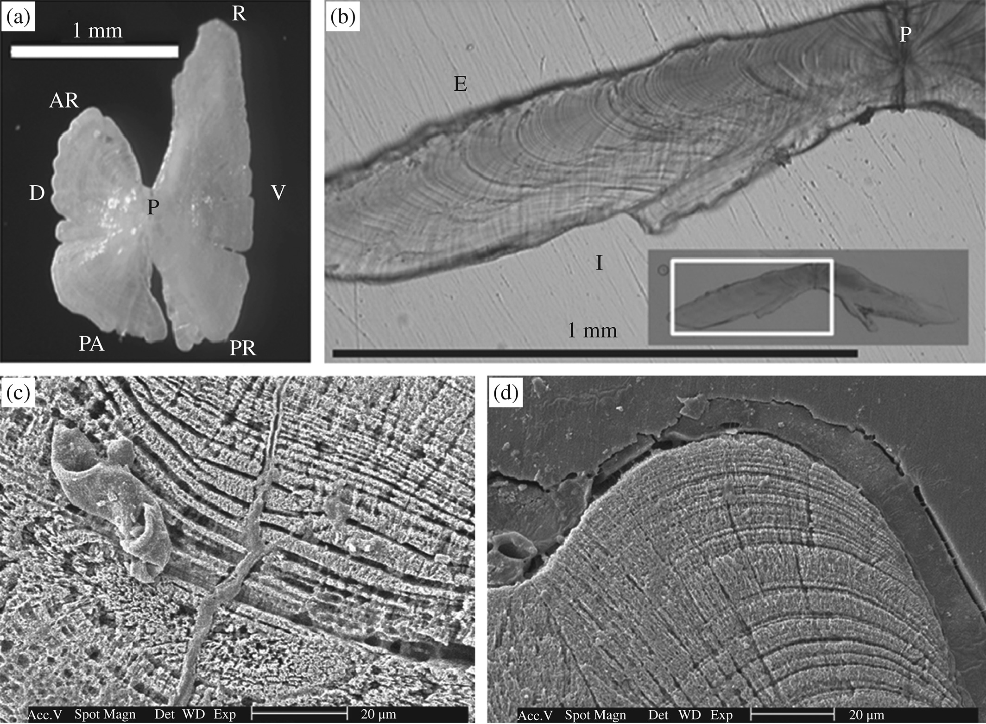
“…Otolith micro-increments were counted assuming daily periodicity. Ages estimated from otoliths ranged from 64 to 659 days. Species longevity about 4 years
von Bertalanffy growth model L∞ = 194·1 cm L_{F}, k = 0·912 year⁻¹ and t₀ = 0·081 years.
“The large variability between scale length and LF and the failure to ascertain increment deposition periodicity suggest that scales are not appropriate for ageing C. hippurus and analysis of otolith micro-increments is deemed the best structure for ageing this species in the study area”

Slide 13
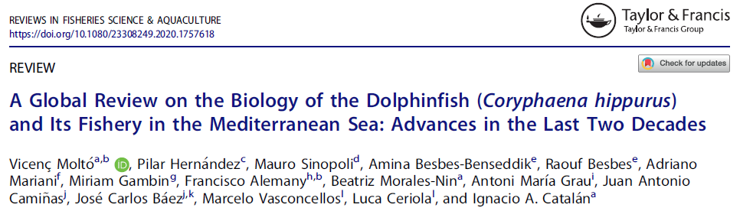
“…The seasonal marks in the cycloid scales of Mediterranean adult fish (size range 65–124 cm FL) resulted in the identification of three age classes with interpretable scales in 93% of the fish examined (Massutí et al. 1999). These authors concluded that scales are the best method for aging adult fish because the DGI in the otoliths caused age underestimates. Schwenke and Buckel (2008), for the dolphinfish in North Carolina waters, also described three age classes and had a consistent interpretation of the scales, with 69% agreement in three readings. They validated the nature of the seasonal growth increments using the marginal growth progression, with maximum growth during summer. In Brazilian waters, Lessa and Santana (2016) found no clear seasonal growth patterns in the scale marginal increments, which led to the conclusion that they were not adequate for age estimation. Similarly, Gatt et al. (2015) did not find any clear seasonal growth in Maltese dolphinfish scales and concluded that they underestimate age”.
DGI = daily growth increment

Slide 14
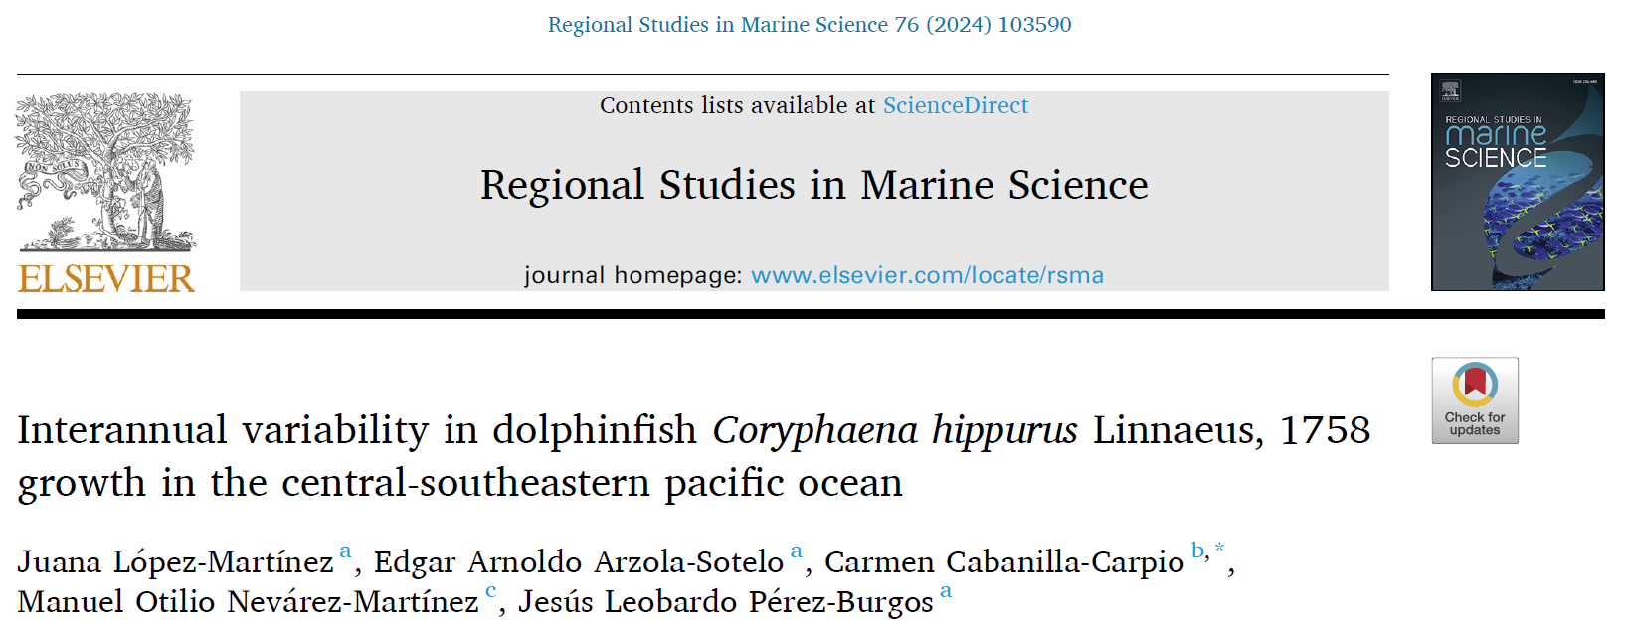
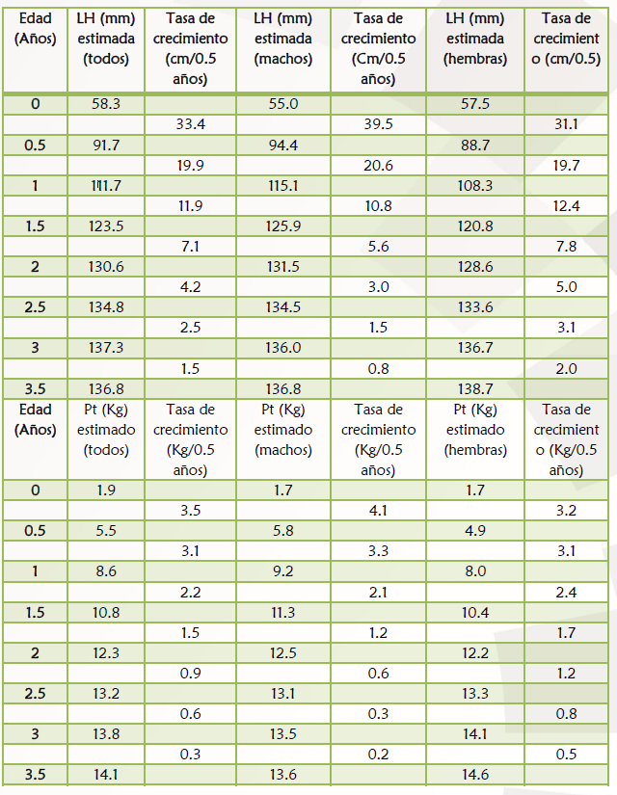
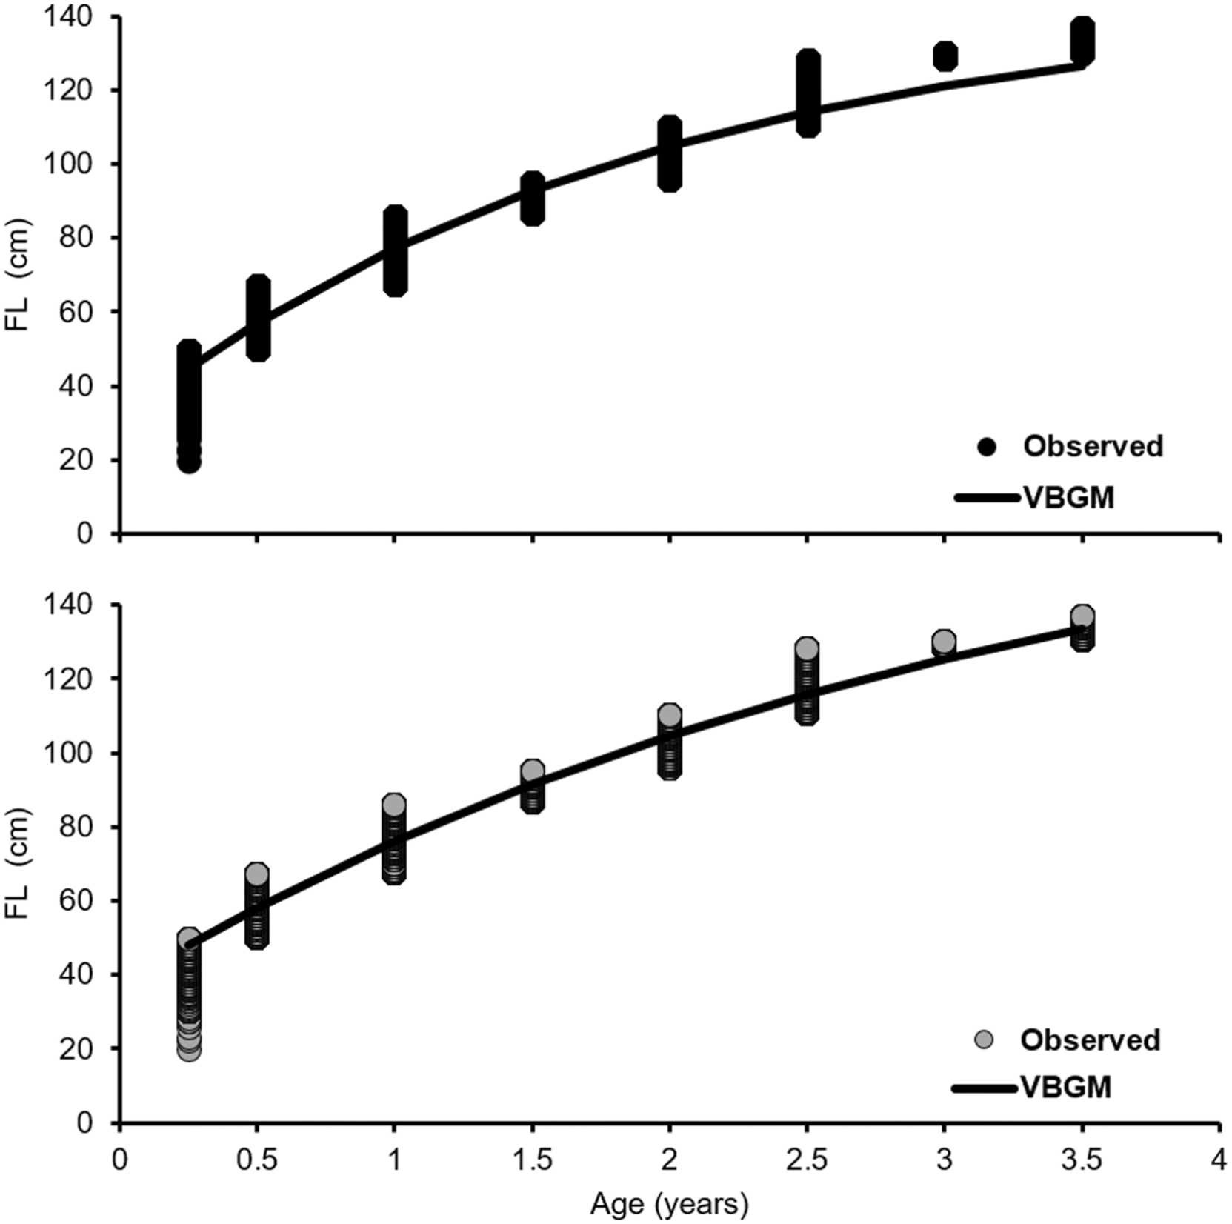
L∞ = 168.6 cm, k = 1.3, t₀ = -0.04”
“Fig. 6. Growth curves of von Bertalanffy (VBGM) selected by the Akaike Information Criterion (AICc and wi) as the best descriptor of the furcal length (FL) age-length of the dolphinfish Coryphaena hippurus in the Ecuadorian Pacific from 2006–2022, assuming multiplicative (above) additive (below) structural errors”.

Slide 15
«An exploited fish stock viewed as a simple biological system» (King 1995) (Images by ChatGPT)
Growth
Recruitment
Natural mortality
Fishing mortality
Reproduction
King, M. (1995). Fisheries biology, assessment and management. Fishing News Books, Oxford, 341

Slide 16
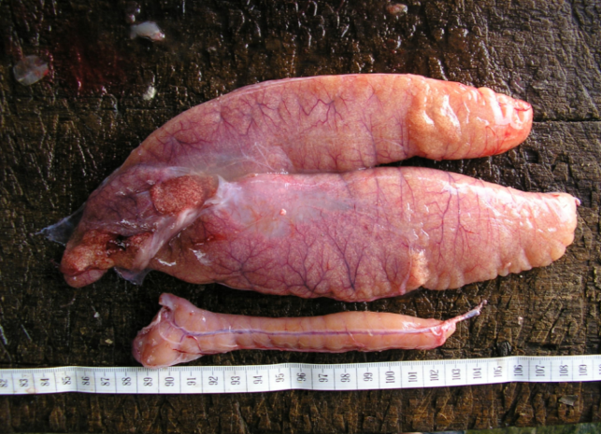
Length and age at maturity
Snook Centropomus undecimalis gonads
https://github.com/DeepWaterIMR/ggFishPlots
Andrade, H., Vihtakari, M., & Santos, J. (2023). Geographic variation in the life history of lane snapper, with new insights from the warm edge of its distribution. Journal of Fish Biology, 103(5), 950-964. doi:https://doi.org/10.1111/jfb.15488

Slide 17
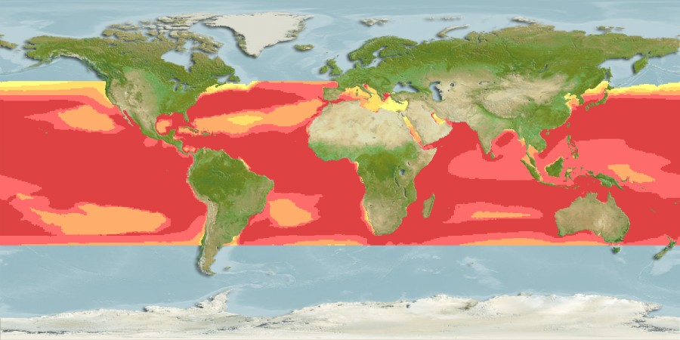
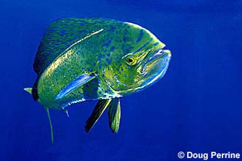
Computer Generated Native Distribution Map for Coryphaena hippurus (Common dolphinfish), with modelled year 2050 native range map based on IPCC RCP8.5 emissions scenario
Currently known distribution: Atlantic, Indian and Pacific: in tropical and subtropical waters.
https://www.aquamaps.org/receive.php?type_of_map=regular&map=cached

Slide 18
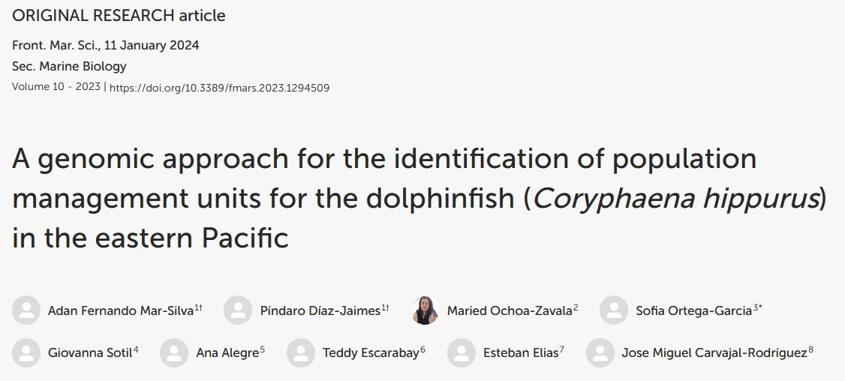
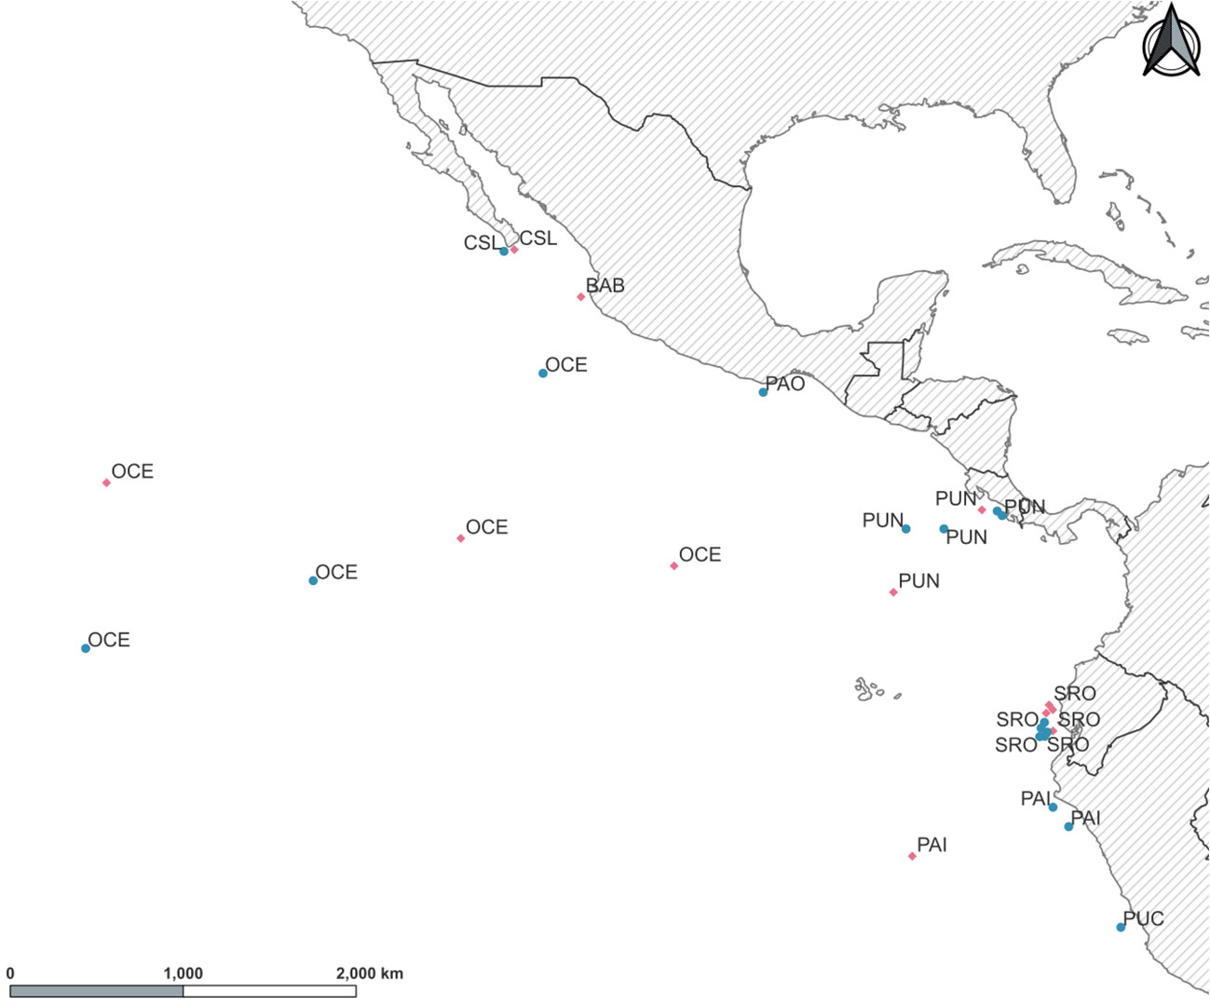
“Overall results show high levels of connectivity across locations in the study area. However, genetic differences were observed for YOY individuals among sites from the northernmost and southernmost areas seemingly related to the spatial separation of locations. This pattern was confirmed also in adult individuals by the significant differences observed between Cabo San Lucas (Northern) and the two Peruvian localities (Southern). Moreover, the Oceanic location presented differences when compared to the shoreline sample sites in the TEP.”
YOY = Young of the year
TEP = Tropical Eastern Pacific
Figure 1 Sampling locations for young of the year (YOY) (pink diamonds) and adult (green circles) individuals of Coryphaena hippurus in the Tropical Eastern Pacific. Localities: Cabo San Lucas (CSL), Bahía Banderas (BAB), Puerto Ángel (PAO), Puntarenas (PUN), Oceanic (OCE), Santa Rosa (SRO), Paita (PAI), and Pucusana (PUC).

Slide 19
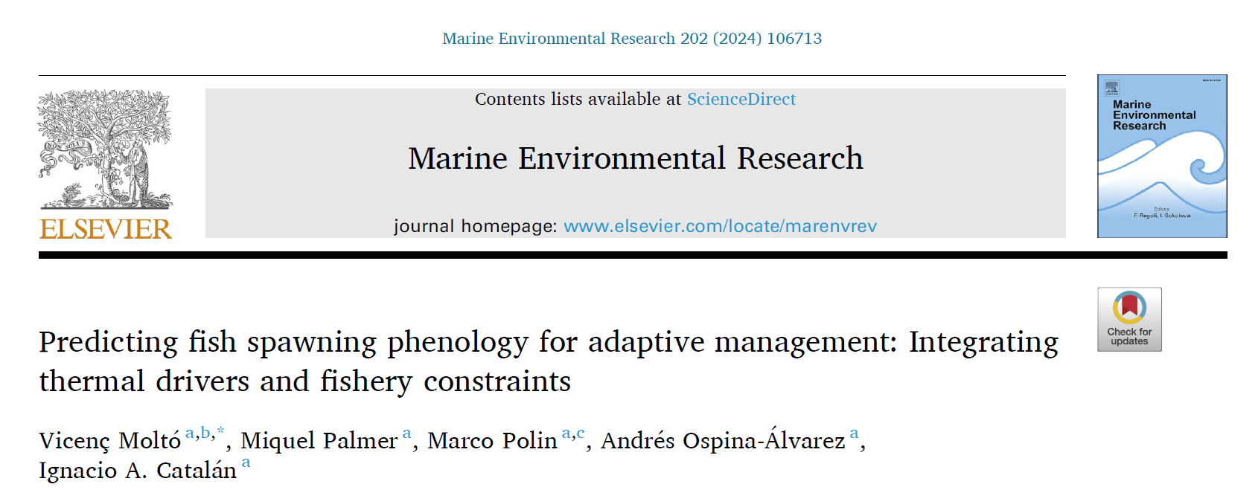
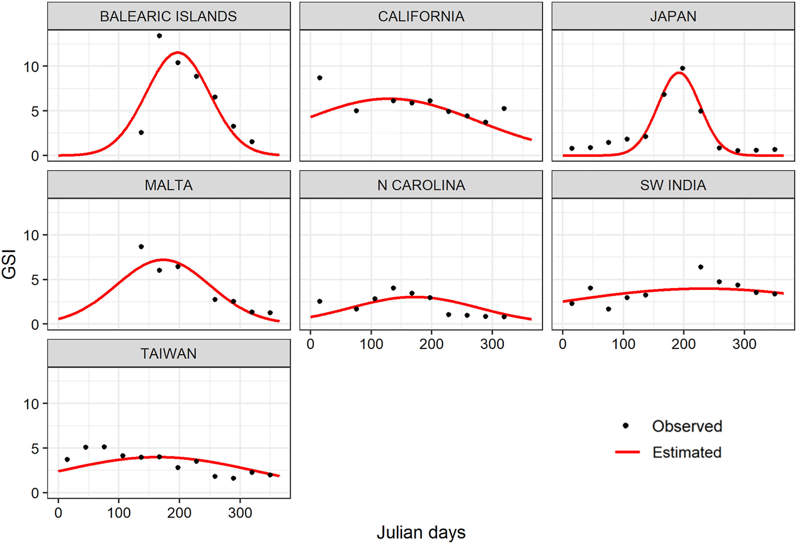
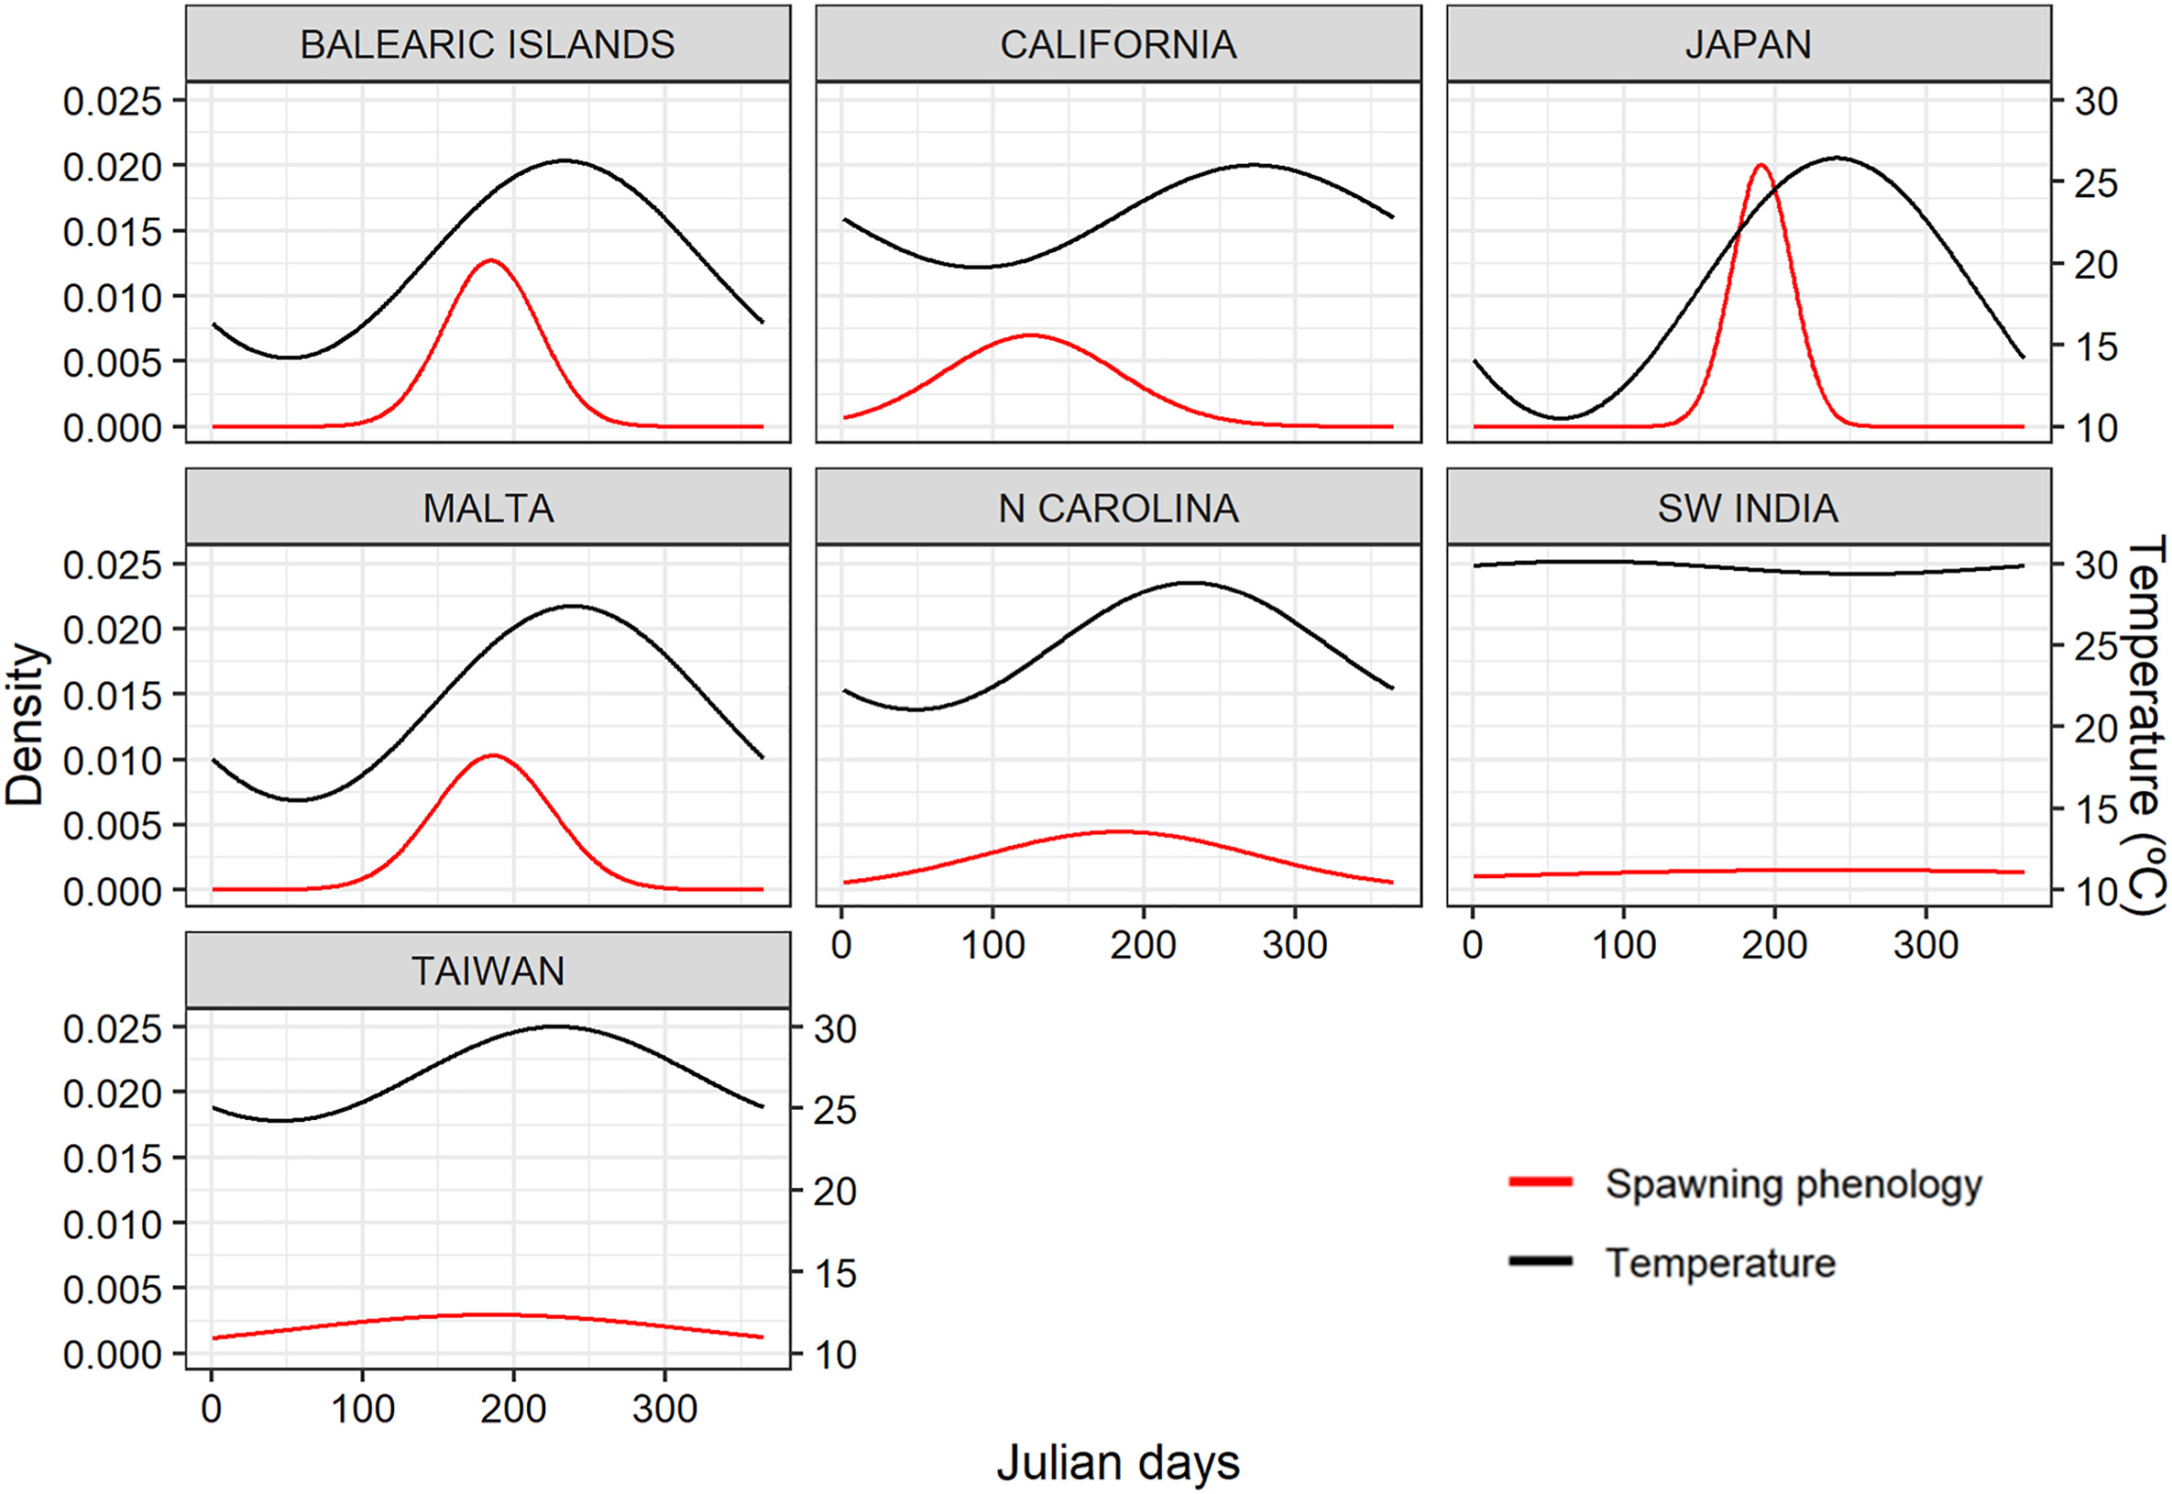
Reproducción dorado
“…higher mean annual temperatures correlate with longer spawning seasons, indicating a broader span of reproductive activity. Conversely, in temperate regions such as the Balearic Islands, Malta, or Japan, lower mean annual temperatures result in shorter, more concentrated spawning periods. In tropical latitudes, the nearly year-round spawning behavior corresponds to consistently low GSI values, reflecting a small proportion of females being reproductively active throughout the year. In contrast, temperate regions show clear GSI peaks during the concentrated spawning period, with GSI values close to zero outside this period…”

Slide 20
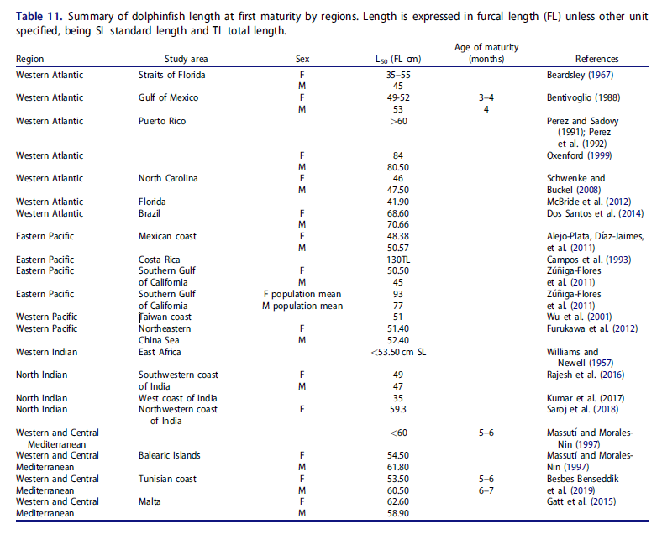
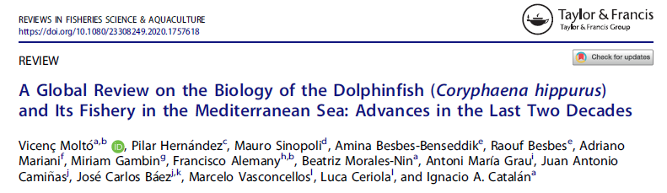
Historia de vida (parámetros)

Slide 21
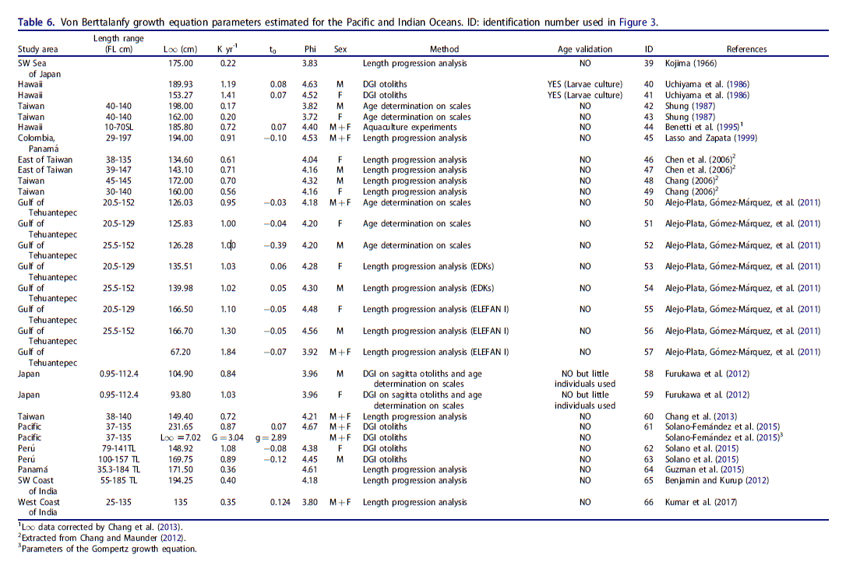

Slide 22
«An exploited fish stock viewed as a simple biological system» (King 1995) (Images by ChatGPT)
Growth
Recruitment
Natural mortality
Fishing mortality
Reproduction
King, M. (1995). Fisheries biology, assessment and management. Fishing News Books, Oxford, 341

Slide 23
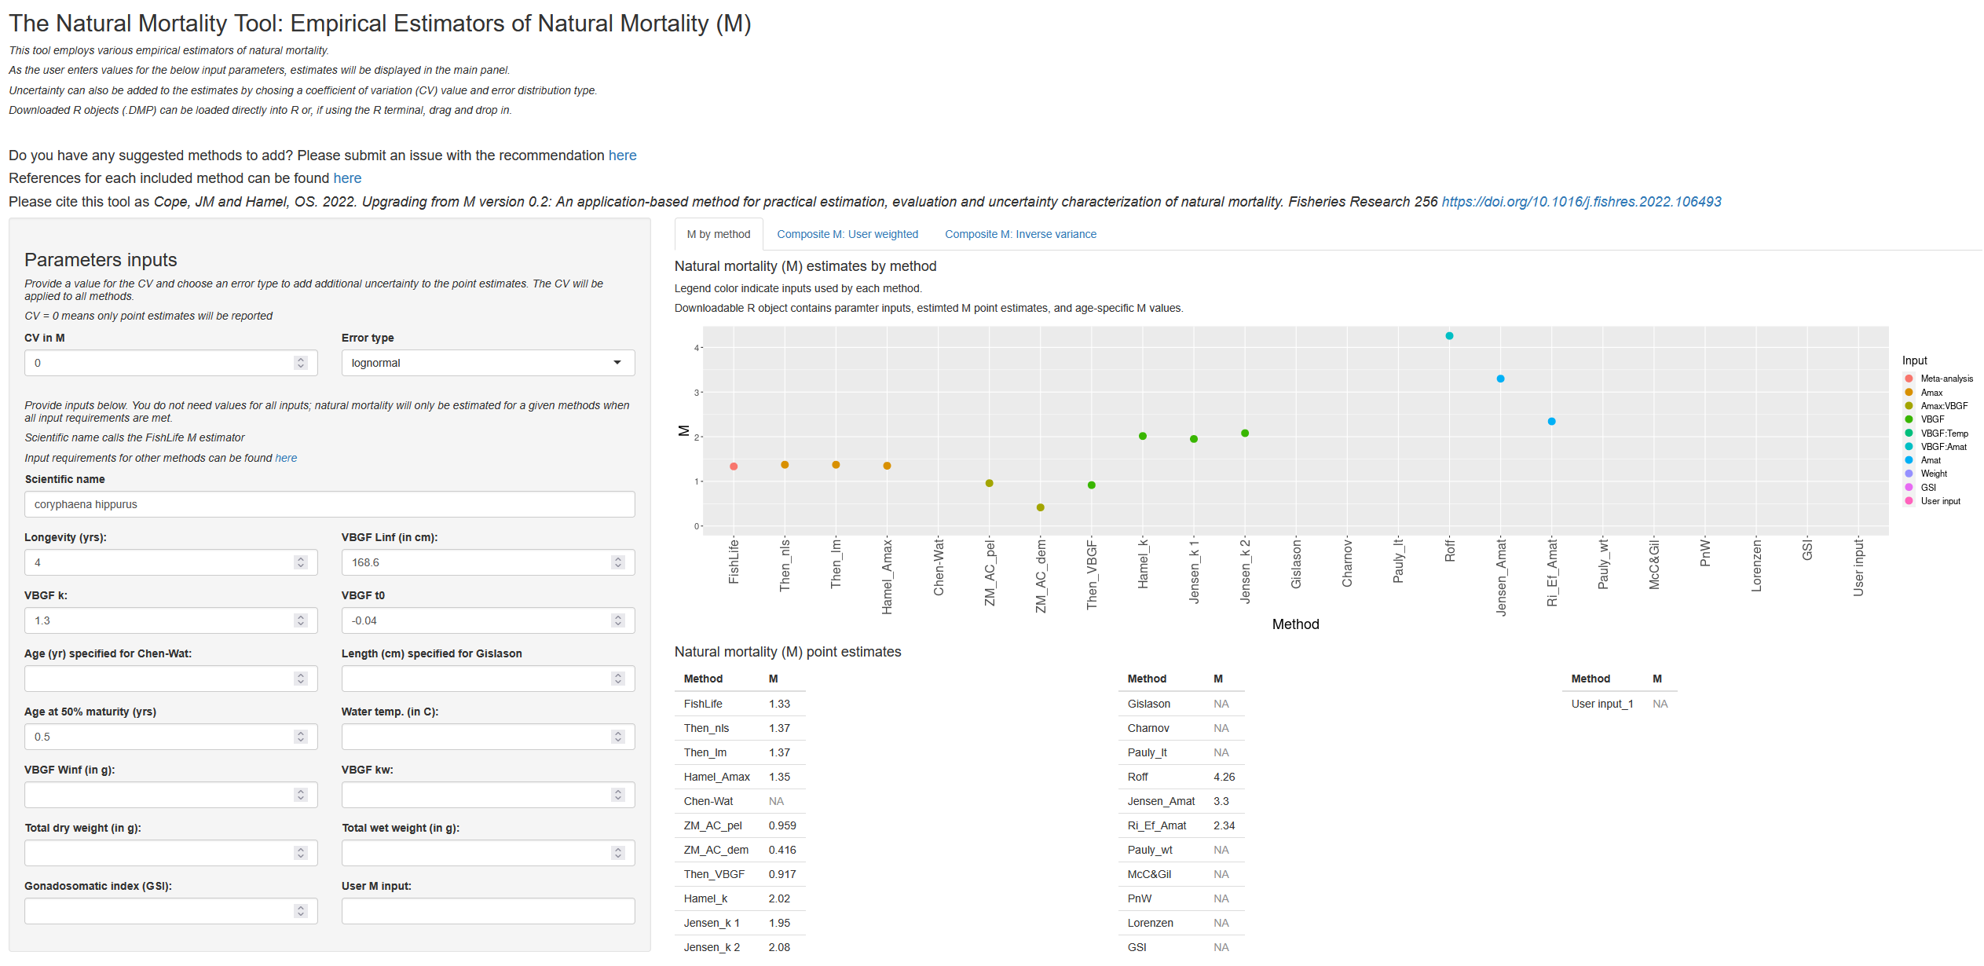
https://connect.fisheries.noaa.gov/natural-mortality-tool/

